Slide 1
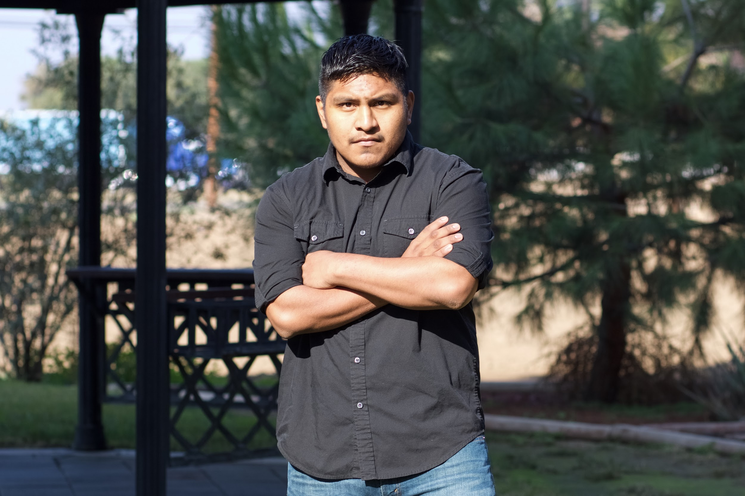
Marcelino Olea-Lopez

Slide 2
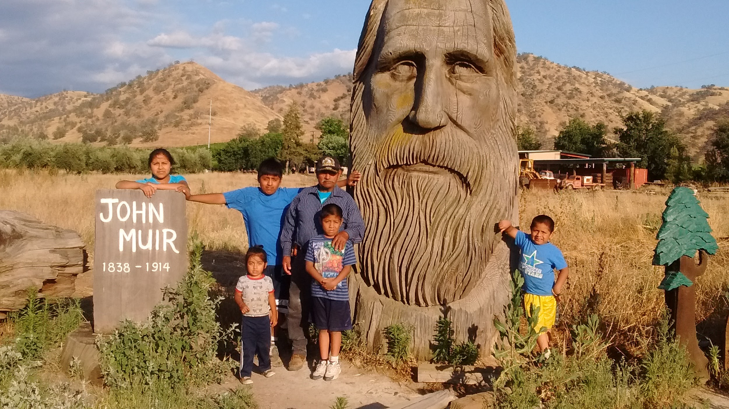
About Me
Family of 8
Two Jobs
My Dad had accident
Grew Up In Poverty
Dismantle
Being Creative

Slide 3
High School Experience
Things I Like
Learning Facilitators are very helpful
Give tools to learn
LF keep use informed
They guide us to make good descisions
Things I Dislike
Schedule
Lunch after 1:00
More Snack Bars
School Should Start at nine
One on one

Slide 4
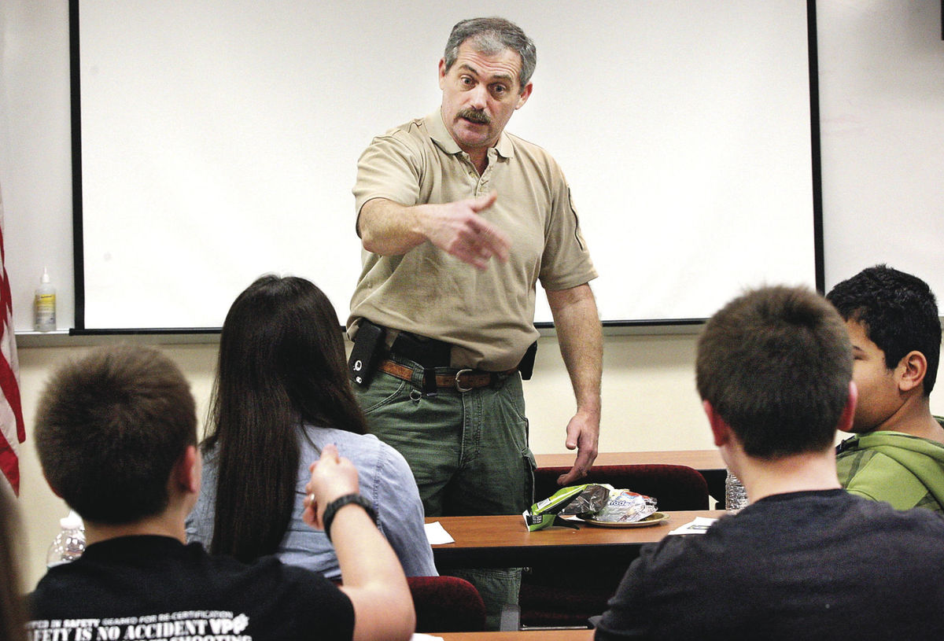
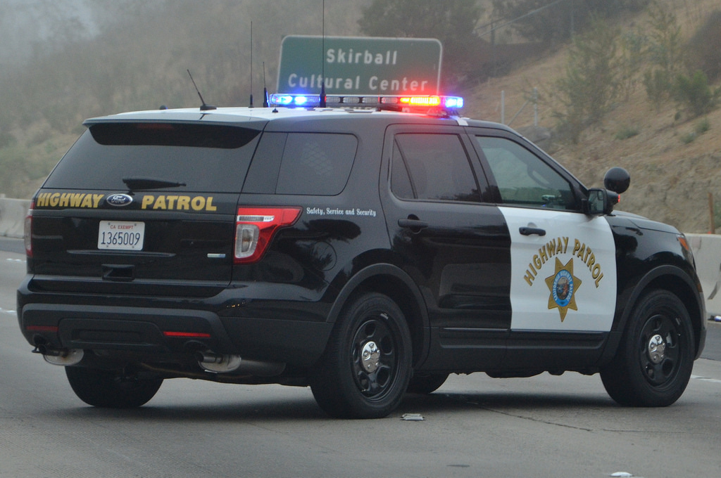
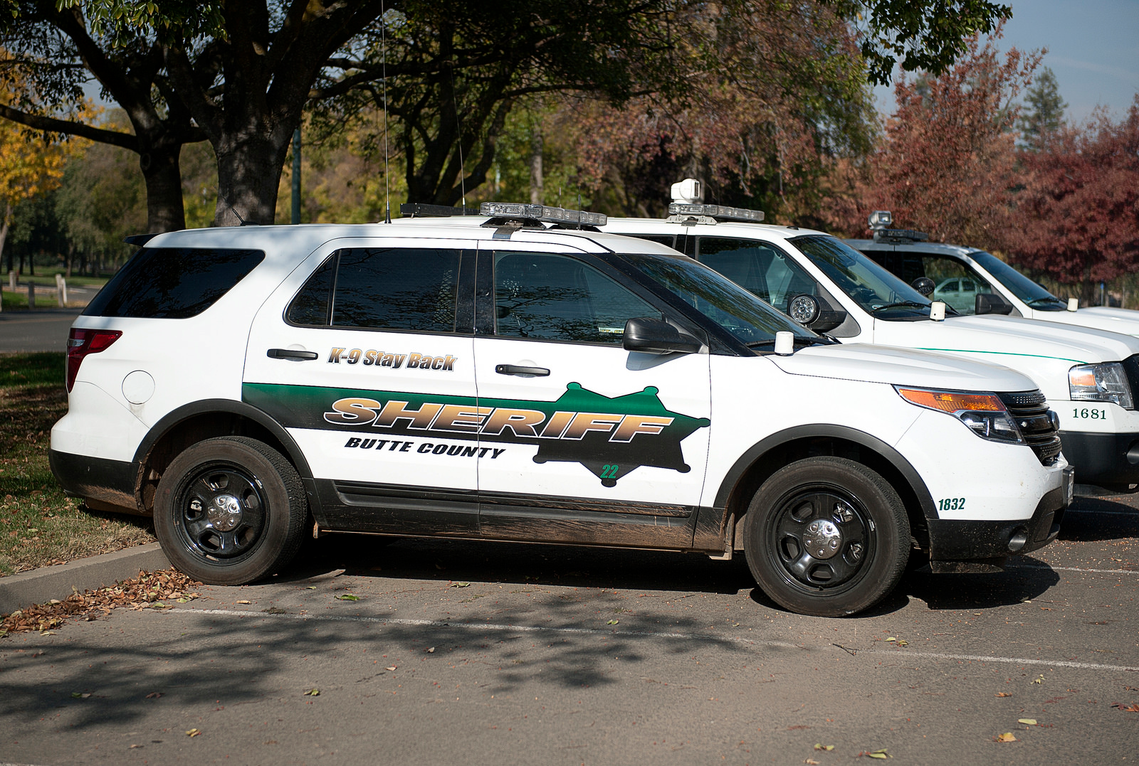
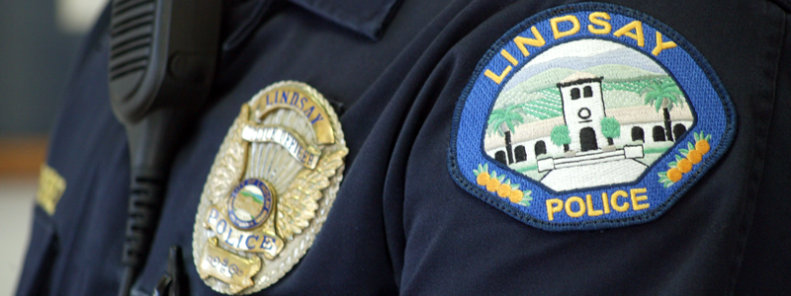
Career
Highway Patrol
Sheriffe
Police Officer
Teacher for Police Academy

Slide 5
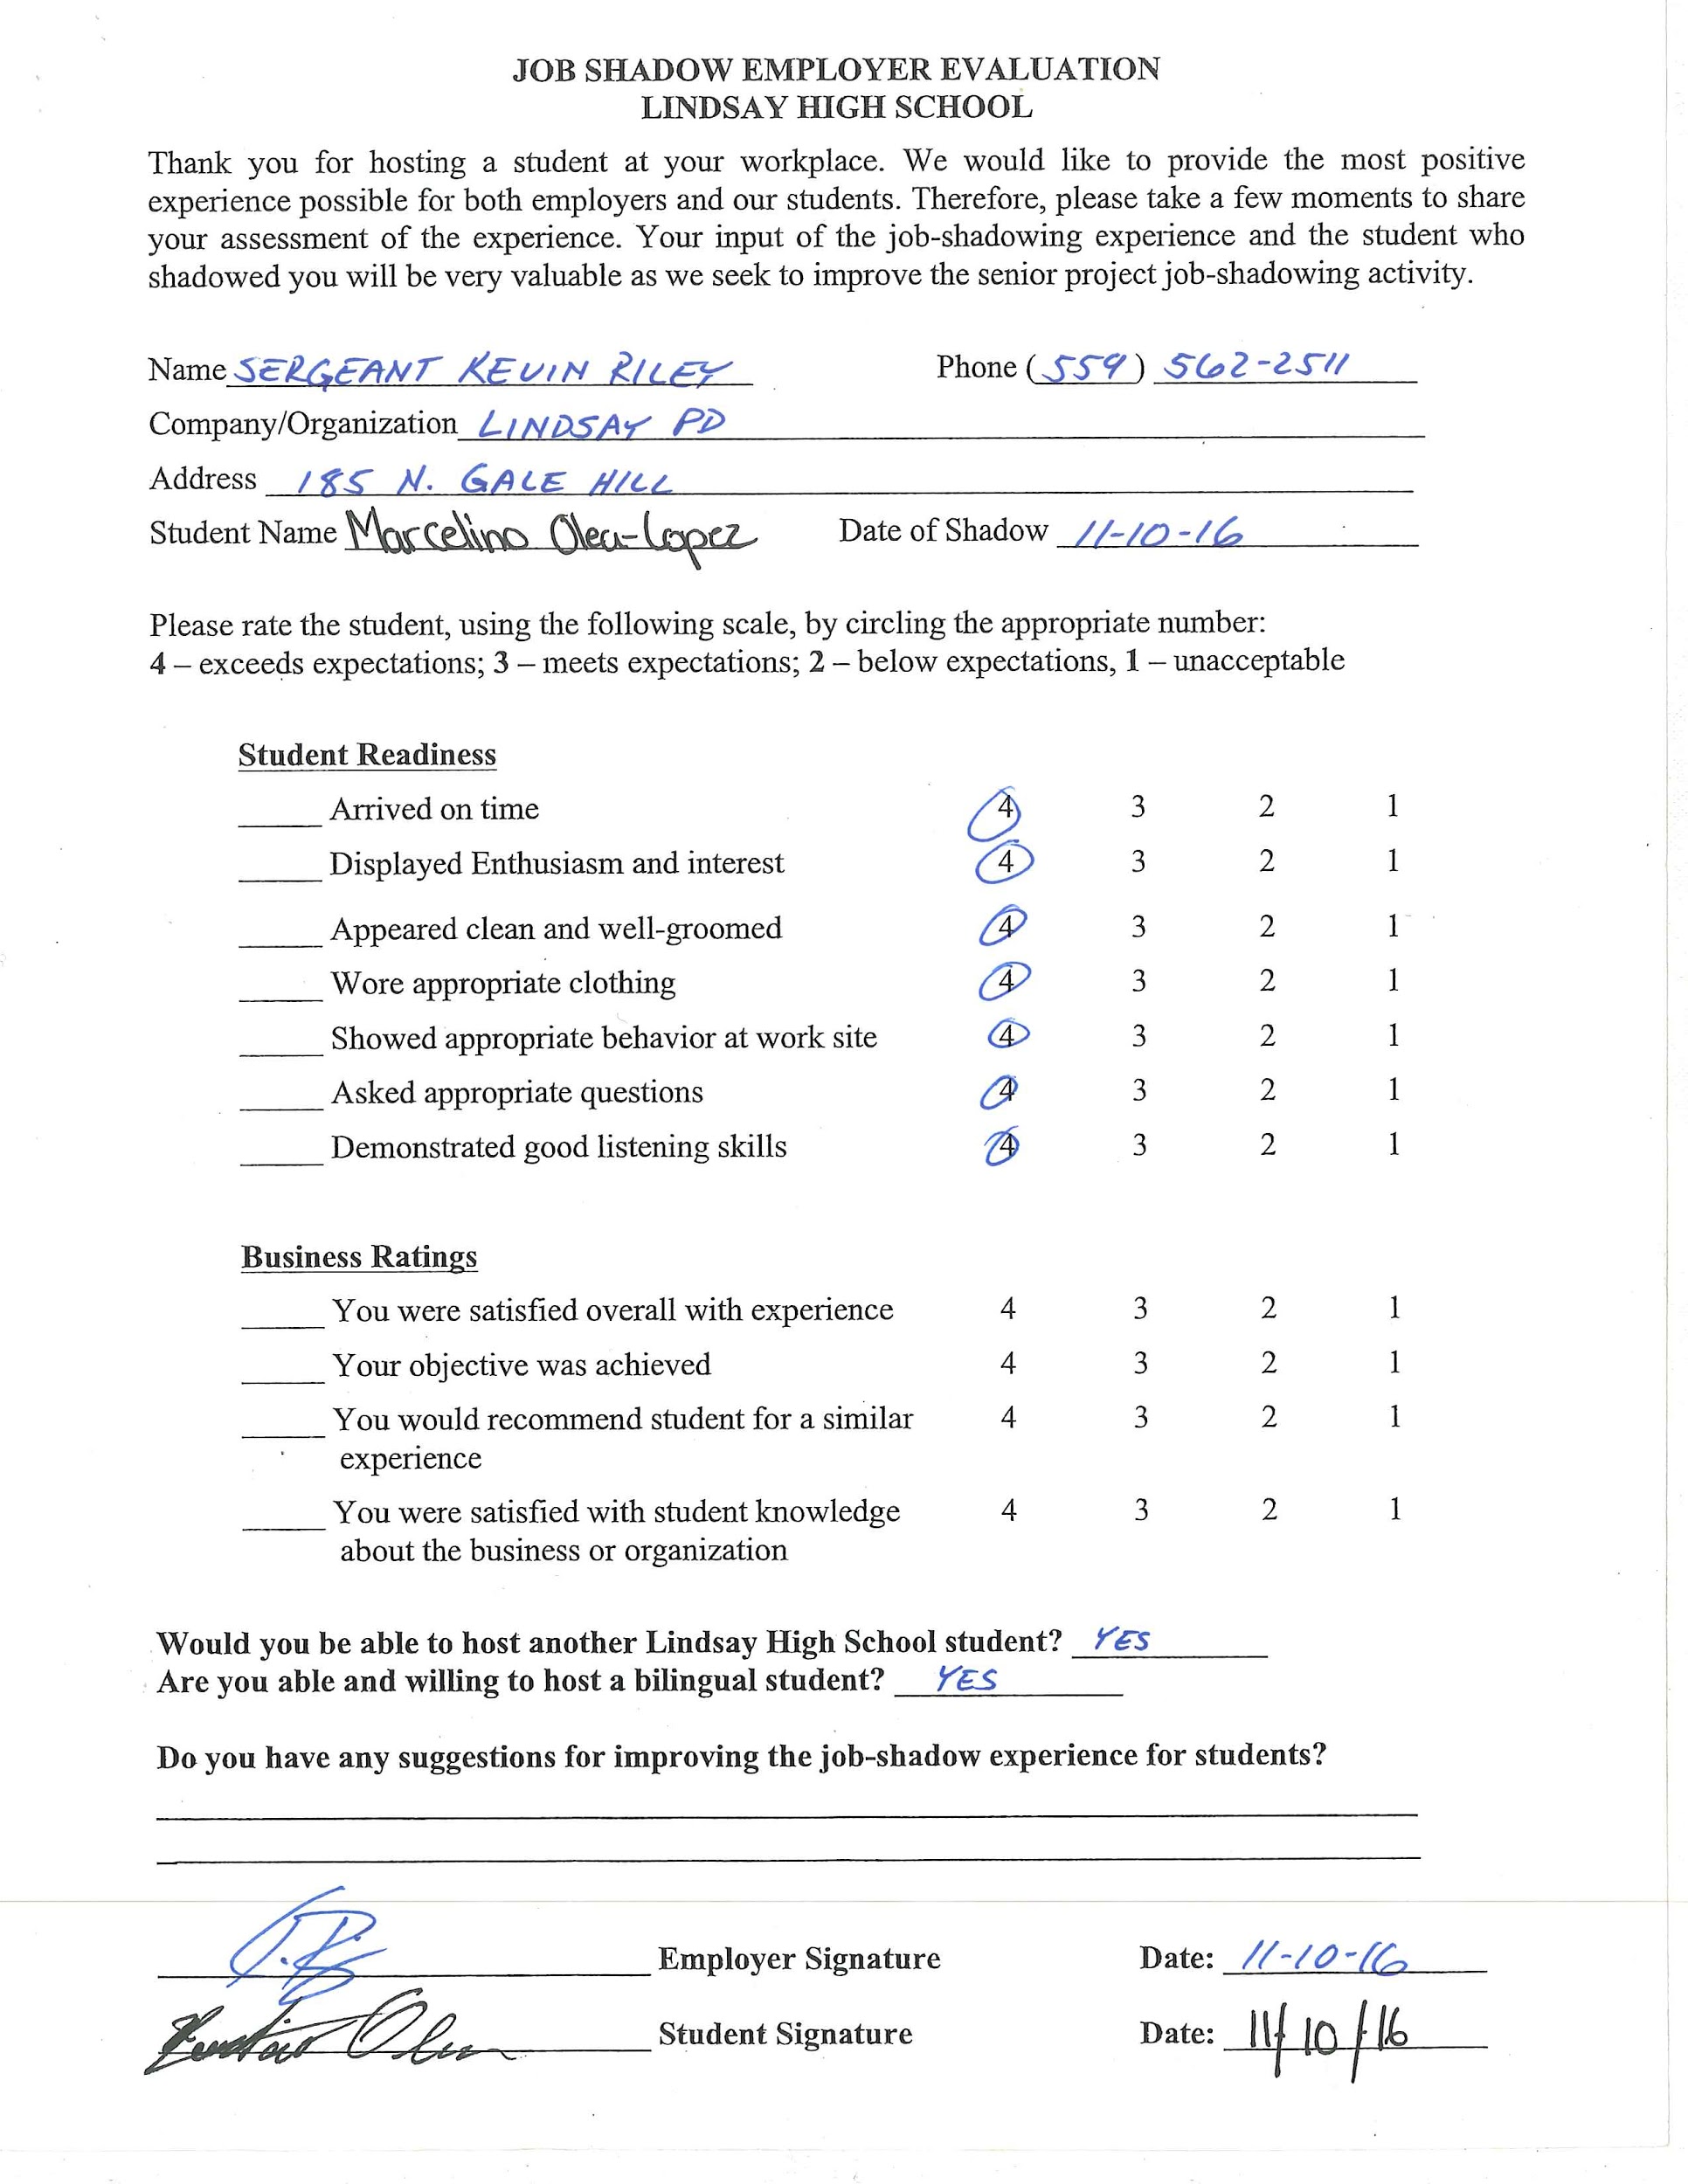
Job Shadow
Sergeant Kevin Riley
LPD
Lot of Experience
Learn what I’m getting into

Slide 6
After High School
Attend COS
Transfer to Fresno State
Attend Hanford Academy

Slide 7
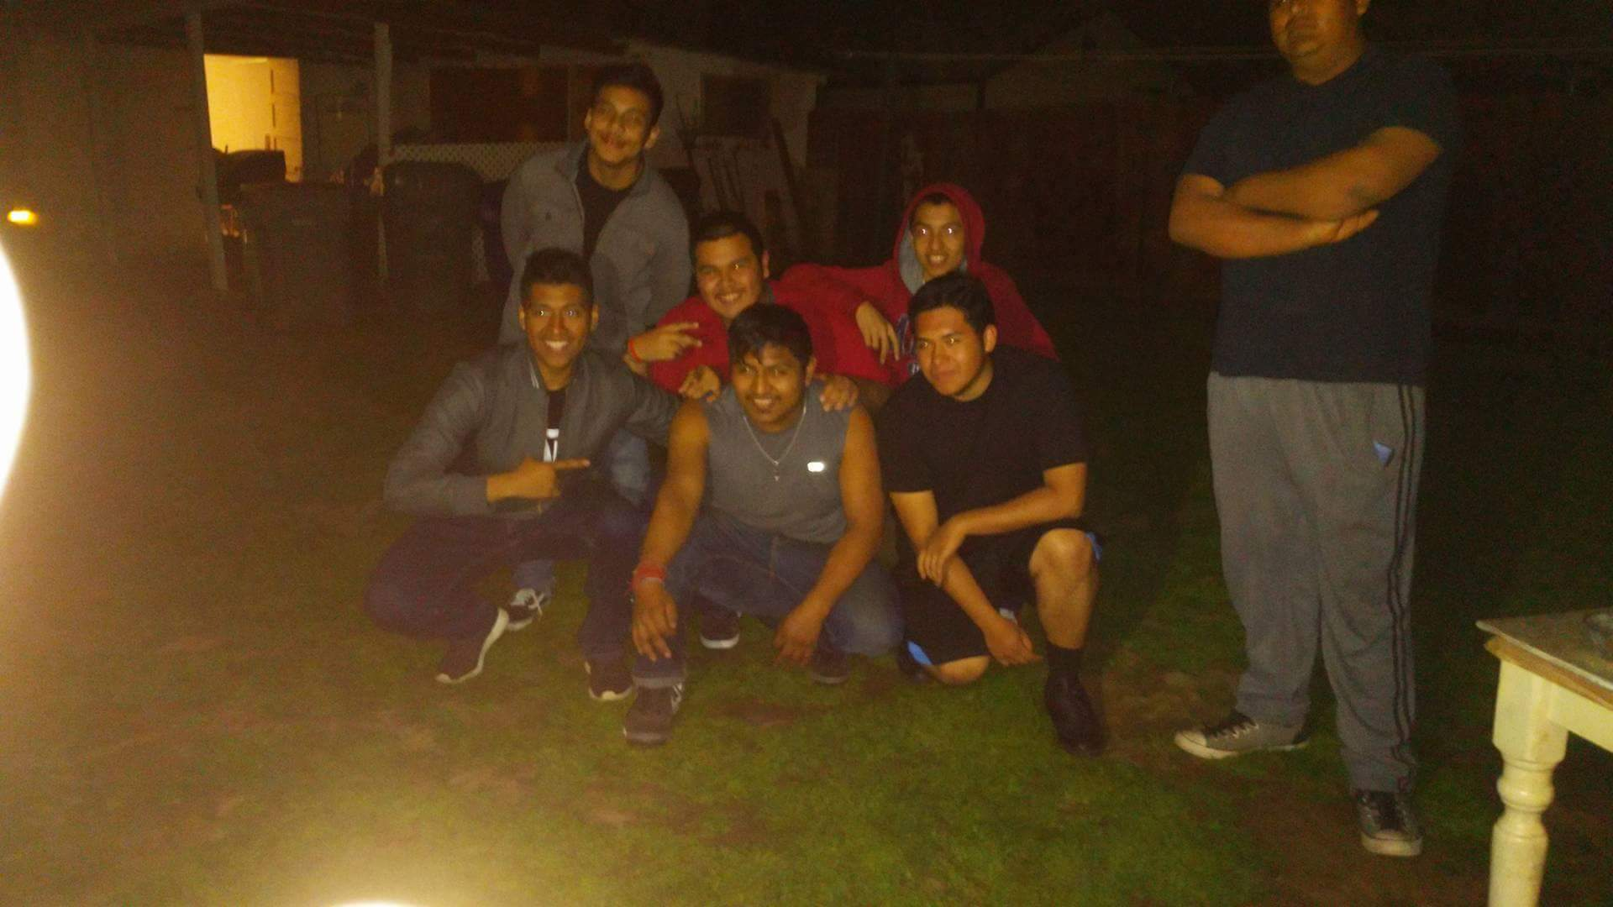
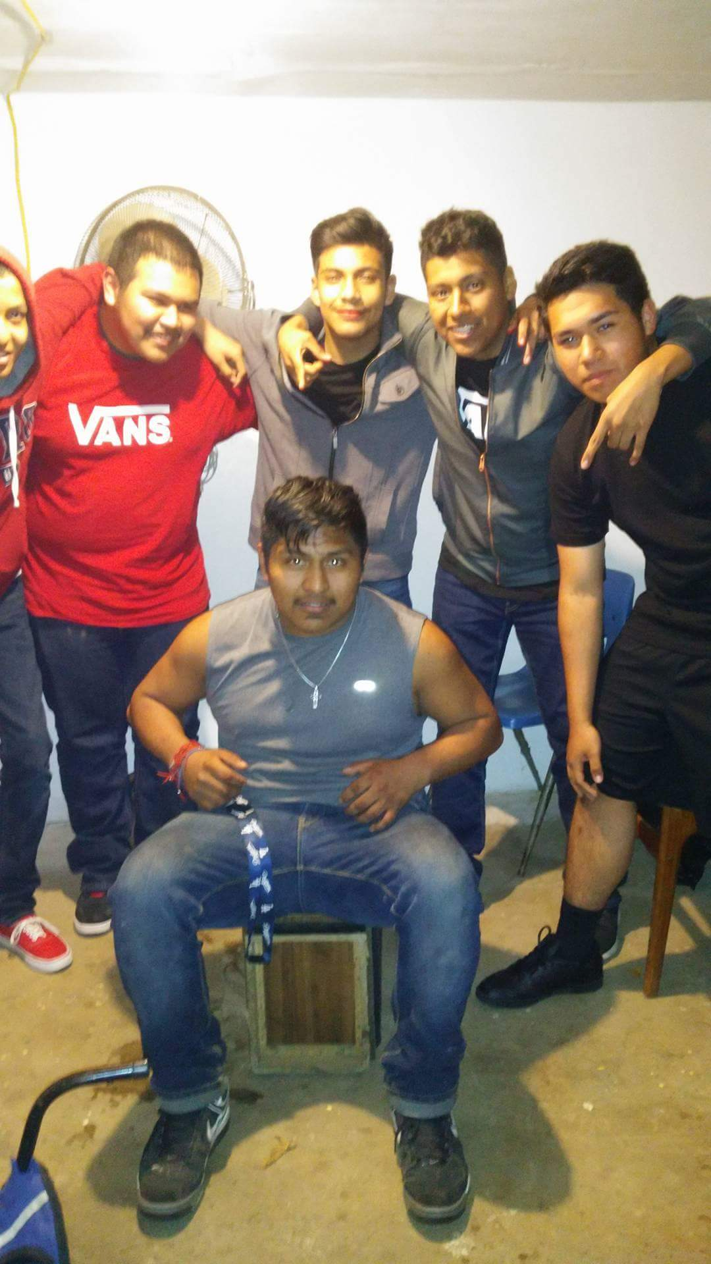
Leaving High School
Met new people and new friends
Helped me become a hard worker
Leaving those teachers that became friends and those friends that became family

